Slide 1


Library Management System
Presented by:
Areeba Sadaqat (47633)

Slide 2


Table of Content
01
Introduction
02
Advantages
03
Overview
04
Goal
05
Features
06
Working
07
Code
06
Conclusion

Slide 3



Introduction
Bash (Bourne Again Shell):
A command-line interpreter for Linux/Unix.
Helps in executing commands and automating repetitive tasks.
Supports scripting to build lightweight tools.
Shell Scripting :
Shell scripting is a method of writing scripts or programs to automate repetitive tasks by writing commands in a script file.
Commonly used for:
File management.
Task automation.
Application management.

Slide 4
Advantages:
Simple, lightweight, and efficient.
No need for advanced programming skills.
Pre-installed on most Linux/Unix systems.
Why Choose Bash for a Library Management System?
It’s fast and lightweight for simple operations.
Doesn’t need extra software to work.
Easy to use for creating scripts.
Helps quickly create and test command-line programs.

Slide 5


Overview
Library Management System developed using Bash scripting. The Library Management System is a project designed to automate the operations of a traditional library. This system allows users to efficiently perform various library-related tasks. By automating library processes, the system eliminates the need for manual record-keeping and reduces the reliance on paper-based operations. Our primary goal is to enhance the Library management system by making it more efficient, organized, and accessible for all users, including students and staff.

Slide 6

Goal
Simplify Library Operations: Automate common tasks like book issuance and return.
Maintain Organized Records: Track book availability and user details.
Role-Based Access: Assign specific permissions for admins, staff, and students.
Time Efficiency: Reduce manual errors and save time in daily operations.

Slide 7


Features
Manage Books:
View all books in the library.
Add or delete books dynamically.
Search books
Edit books
Manage Students:
Add new students to the database.
View and delete existing student records.
Issue and Return books

Slide 8


How It Works?
Menu-driven Interface:
Main menu with options for managing books, students, and staff.
Easy-to-navigate structure.
Data Storage:
Utilizes Bash arrays for temporary storage.
No external database dependency.
Admin Authentication:
Secure access for staff management through login.
Dynamic Updates:
Additions and deletions are reflected immediately.
.

Slide 9
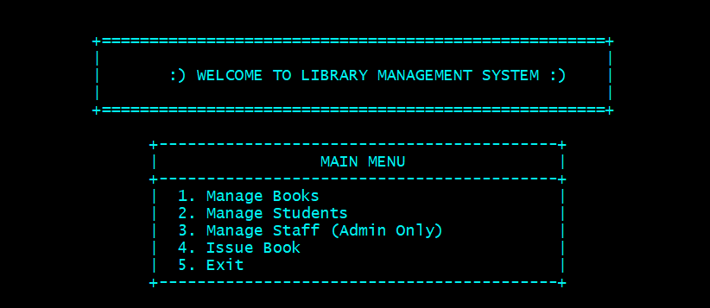

Code
.
Main Menu of the Library Management System

Slide 10
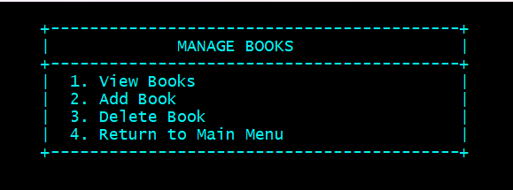
.
Manage Books

Slide 11
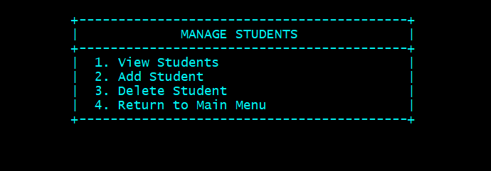
.
Manage Students

Slide 12
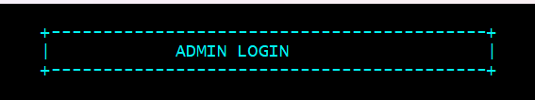
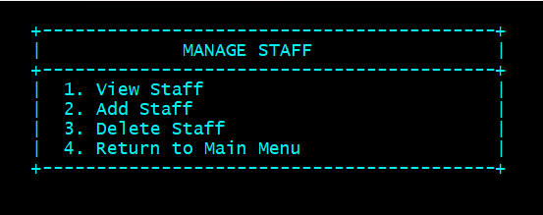
Manage Staff
.

Slide 13
Issue Book
.

Slide 14

Conclusion
This project demonstrates the use of Bash scripting to build a functional and lightweight Library Management System.
The system provides essential features like managing books, students, staff, and book issuance through a simple Command-Line Interface.

Slide 15

Any question

Slide 16



THANK YOU

